Slide 1

Bass-Norton Monte Carlo
UpTahr Analytics
Sam Neubauer
October 22, 2020

Slide 2
Data / Problem
Problem: m, p, and q values are difficult to predict in the middle of a durable’s generation
This Model: Trains model with first 8 of 10 yearly sales data → Predicts sales of last 2 years.
Arbitrary Data: [ 0 840 1470 2110 4000 7590 10950 10530 9470 ]

Slide 3
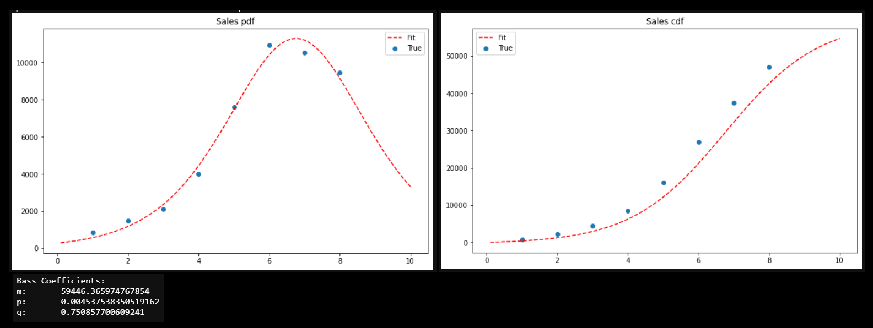
m, p, q from Least Squared Fitting Method

Slide 4
Monte Carlo
Useful when a forecast is difficult to predict from traditional models

Slide 5
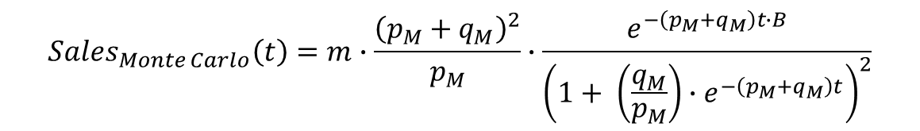
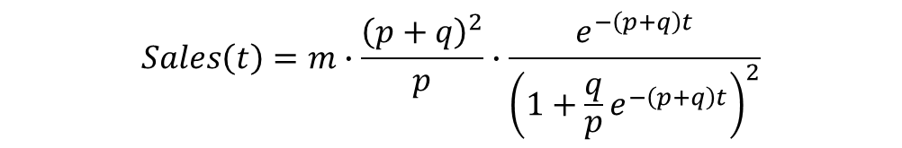
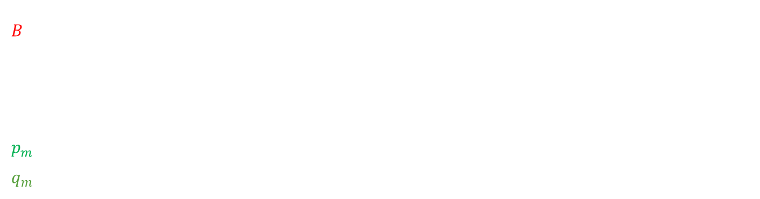
$$Sales\left(t\right)=m∙\frac{{\left(p+q\right)}^{2}}{p}∙\frac{e^{−\left(p+q\right)t}}{{\left(1+\frac{q}{p}e^{−\left(p+q\right)t}\right)}^{2}}$$
Traditional Bass:
Where m, p, q are estimated from fit/approx. method
(we use Least Squares Fit to estimate initial m, p, q values)
$${Sales}_{Monte Carlo}\left(t\right)=m∙\frac{{\left(p_{M}+q_{M}\right)}^{2}}{p_{M}}∙\frac{e^{−\left(p_{M}+q_{M}\right)t∙B}}{{\left(1+ \left(\frac{q_{M}}{p_{M}}\right){∙e}^{−\left(p_{M}+q_{M}\right)t}\right)}^{2}}$$
Monte Carlo Bass:
$$B=Z_{e}∙\left(Drift+ σ_{\%∆data}∙\left[Random Number from Norm. Dist.\right]\right); Z_{e}:Weighting Factor [1]$$
where $Drift={mean }_{\%∆data}−(\frac{{Variance}_{\%∆data}}{2})$; $\%∆data=\ln\left(1+sales data\right)$
$$p_{m}= p_{LS}∙(1+Z_{p}∙\left[Random Number from p_{LS} Norm. Dist.\right]; Z_{p}:Weighting Factor [0.5]$$
$q_{m}= q_{LS}∙(1+Z_{q}∙\left[Random Number from q_{LS} Norm. Dist.\right]; Z_{q}:Weighting Factor$ [0.5]

Slide 6
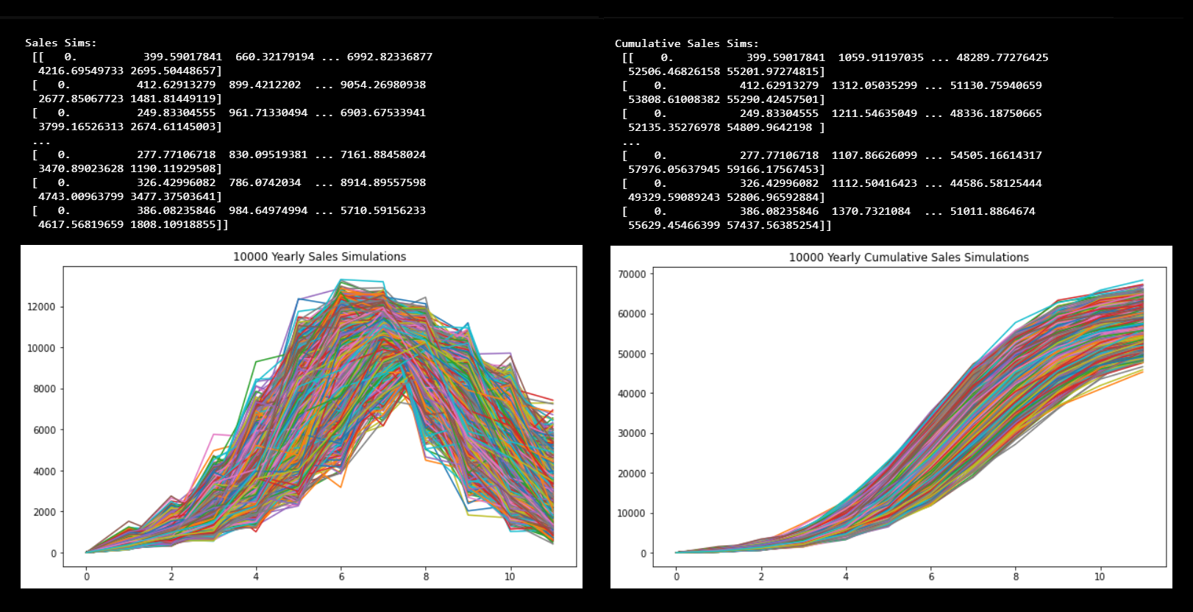
Monte Carlo Sims w/ Brownian Drift (Stock Market Analogue) & Randomized p/q from Normalized Distribution – 2yr. Lookahead

Slide 7
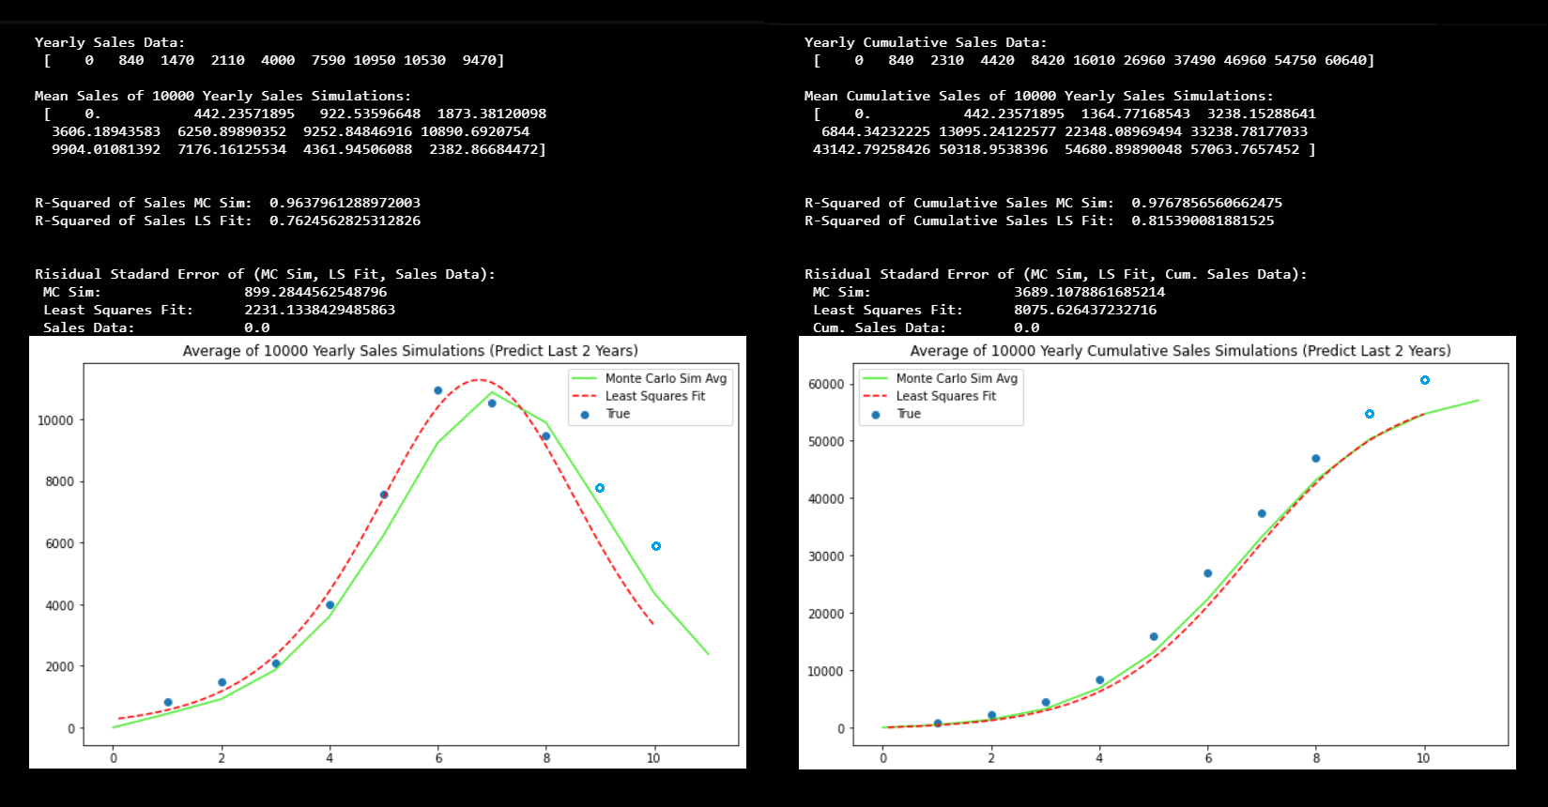
Monte Carlo 2 Year Lookahead Better Than Least Squares Fit

